Slide 1
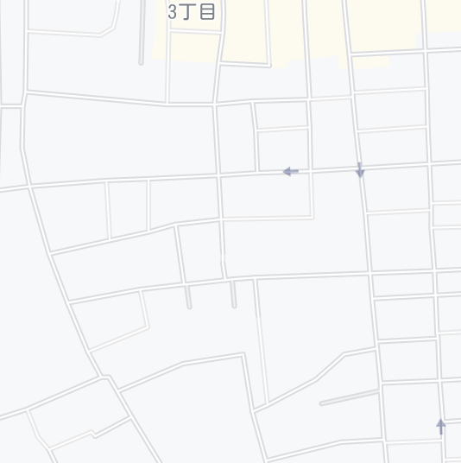
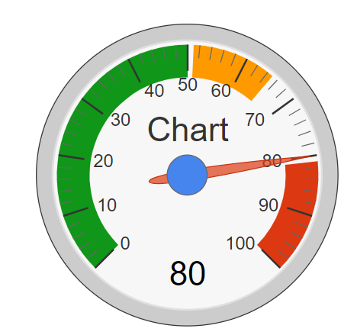

Technical Details
Domain modeling
Shelter: sid, name, address, lat, lng, capacity, isActive, manager
Citizen: cid, name, email, password, home address, # of families
Check-In: id, cid, sid, check-in datetime, check-out datetime
Search shelters by distance
Obtain current (x,y) from GPS
Find shelters S(lng, lat) such that ; d(lng, lat) = 6371 * acos (cos(rad(y)) * cos(rad(lat)) * cos(rad(lng) – rad(x)) + sin(rad(y))*sin(rad(lat))) <= D
Calculate density of shelter
CheckIn(S): # of families currently checked in S
Capacity(S): Max # of families S can accommodate
Density(S) = CheckIn(S) / Capacity(S)
Shelter
1
0..*
Check-In
Citizen
0..*
1
D
Notes:
I will talk about technical details.
First, Domain modeling defines data structure and relationships of Shelter Navi. The main entities are shelter and citizen and check-in.
Each entity as these data items and check-in records which citizen is in which shelter.
Second, How does the system search shelters by distance?
System obtains current (x,y) from GPS and find shelters S(lng,lat) such that this equation is satisfied.
This equation searches the shelters whose coordinates are nearer than distance(D) form current position (x,y)
Third, how does the system calculate density of shelter?
CheckIn(S) represents the number of families currently checked in S.
Capacity(S) represents the max number of families S can accommodate.
Density(S) equal CheckIn(S) divided by Capacity(S).
///////////
(Shelter’s data is shelter-id, name, address, latitude, longitude, isActive, and manager.
Citizen’s data is shelter-id, name, email, password, home address and number of families.
Check-in‘s data is id, shelter-id, citizen-id, check-in datetime and check-out datetime.)

Slide 2
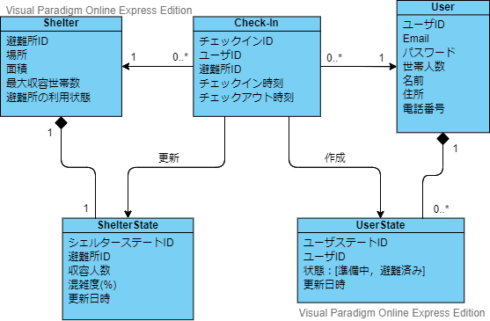
ドメインモデリング
Notes:
ここでどのようなエンティティがあるのか，それぞれのエンティティがどのように結びつき，役割を果たすのか簡単に説明

Slide 3
避難所エンティティ

Slide 4
避難所エンティティ
避難所に関する静的な情報を取り扱う
ID
避難所の識別子
名称
検索結果、避難所の検索
住所
検索結果、避難所の検索
緯度、経度
地図上へ反映させるための位置情報
面積
最大収容世帯数の計算
最大収容世帯数
混雑状況の計算
利用状態
現在利用可能かどうかの表示

Slide 5
ユーザエンティティ
Notes:
I will talk about technical details.
First, Domain modeling defines data structure and relationships of Shelter Navi. The main entities are shelter and citizen and check-in.
Each entity as these data items and check-in records which citizen is in which shelter.
Second, How does the system search shelters by distance?
System obtains current (x,y) from GPS and find shelters S(lng,lat) such that this equation is satisfied.
This equation searches the shelters whose coordinates are nearer than distance(D) form current position (x,y)
Third, how does the system calculate density of shelter?
CheckIn(S) represents the number of families currently checked in S.
Capacity(S) represents the max number of families S can accommodate.
Density(S) equal CheckIn(S) divided by Capacity(S).
///////////
(Shelter’s data is shelter-id, name, address, latitude, longitude, isActive, and manager.
Citizen’s data is shelter-id, name, email, password, home address and number of families.
Check-in‘s data is id, shelter-id, citizen-id, check-in datetime and check-out datetime.)

Slide 6
ユーザエンティティ

Slide 7
チェックインエンティティ
Notes:
I will talk about technical details.
First, Domain modeling defines data structure and relationships of Shelter Navi. The main entities are shelter and citizen and check-in.
Each entity as these data items and check-in records which citizen is in which shelter.
Second, How does the system search shelters by distance?
System obtains current (x,y) from GPS and find shelters S(lng,lat) such that this equation is satisfied.
This equation searches the shelters whose coordinates are nearer than distance(D) form current position (x,y)
Third, how does the system calculate density of shelter?
CheckIn(S) represents the number of families currently checked in S.
Capacity(S) represents the max number of families S can accommodate.
Density(S) equal CheckIn(S) divided by Capacity(S).
///////////
(Shelter’s data is shelter-id, name, address, latitude, longitude, isActive, and manager.
Citizen’s data is shelter-id, name, email, password, home address and number of families.
Check-in‘s data is id, shelter-id, citizen-id, check-in datetime and check-out datetime.)

Slide 8
チェックインエンティティ
ここの説明でSearchShelterByDistance（）の説明もする？

Slide 9
避難所の状態
Notes:
I will talk about technical details.
First, Domain modeling defines data structure and relationships of Shelter Navi. The main entities are shelter and citizen and check-in.
Each entity as these data items and check-in records which citizen is in which shelter.
Second, How does the system search shelters by distance?
System obtains current (x,y) from GPS and find shelters S(lng,lat) such that this equation is satisfied.
This equation searches the shelters whose coordinates are nearer than distance(D) form current position (x,y)
Third, how does the system calculate density of shelter?
CheckIn(S) represents the number of families currently checked in S.
Capacity(S) represents the max number of families S can accommodate.
Density(S) equal CheckIn(S) divided by Capacity(S).
///////////
(Shelter’s data is shelter-id, name, address, latitude, longitude, isActive, and manager.
Citizen’s data is shelter-id, name, email, password, home address and number of families.
Check-in‘s data is id, shelter-id, citizen-id, check-in datetime and check-out datetime.)

Slide 10
避難所の状態

Slide 11
ユーザの状態
Notes:
I will talk about technical details.
First, Domain modeling defines data structure and relationships of Shelter Navi. The main entities are shelter and citizen and check-in.
Each entity as these data items and check-in records which citizen is in which shelter.
Second, How does the system search shelters by distance?
System obtains current (x,y) from GPS and find shelters S(lng,lat) such that this equation is satisfied.
This equation searches the shelters whose coordinates are nearer than distance(D) form current position (x,y)
Third, how does the system calculate density of shelter?
CheckIn(S) represents the number of families currently checked in S.
Capacity(S) represents the max number of families S can accommodate.
Density(S) equal CheckIn(S) divided by Capacity(S).
///////////
(Shelter’s data is shelter-id, name, address, latitude, longitude, isActive, and manager.
Citizen’s data is shelter-id, name, email, password, home address and number of families.
Check-in‘s data is id, shelter-id, citizen-id, check-in datetime and check-out datetime.)

Slide 12
ユーザの状態

Slide 13
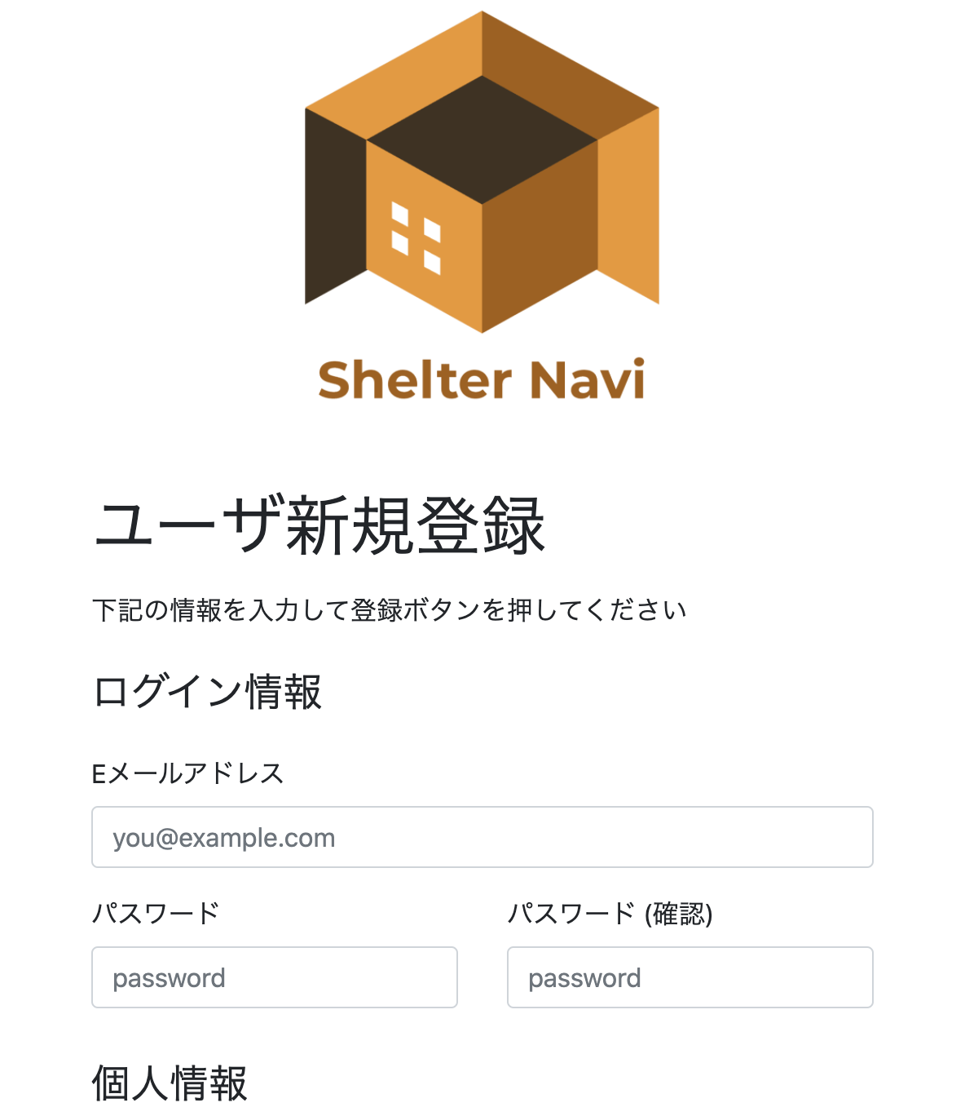
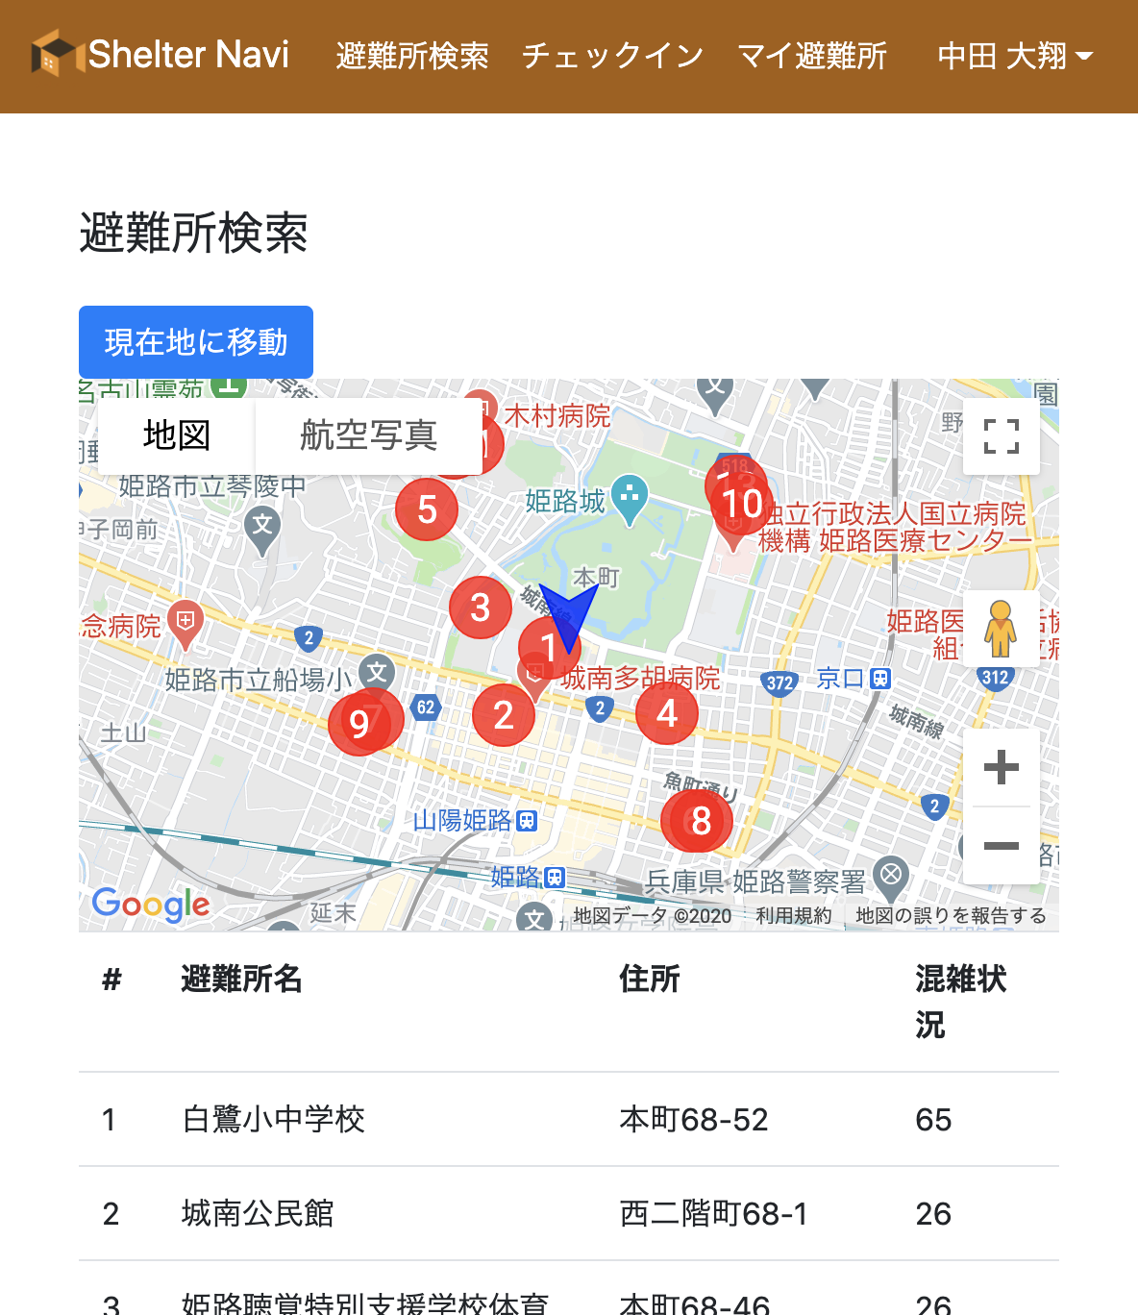
Screenshots of Prototype
We are currently implementing Shelter Navi with open data of Kobe City and Himeji City
Notes:
We are currently implementing Shelter Navi with open data of Kobe City and Himeji City.
These are screenshots of Prototype.
This screen shows user registration screen where the citizen registers personal information.
This screen shows shelter search screen in which the position of each shelter is marked by a circle.
Below shows the shelters name and address and capacity.

Slide 14
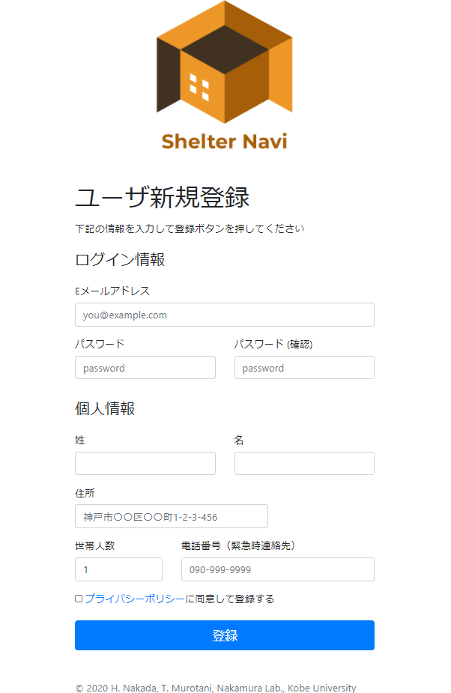
ShelterNaviプロトタイプ
ログイン画面

Slide 15
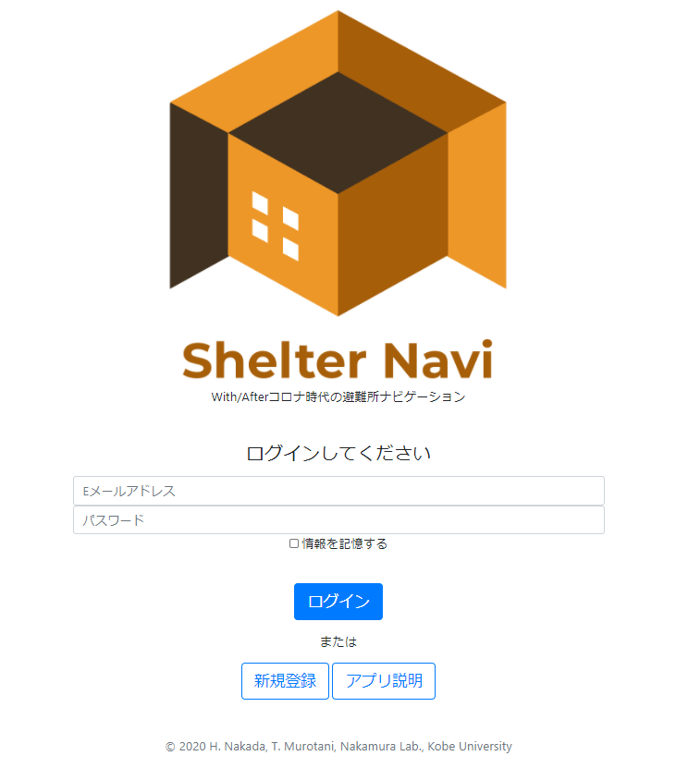
ShelterNaviプロトタイプ
ログイン画面

Slide 16
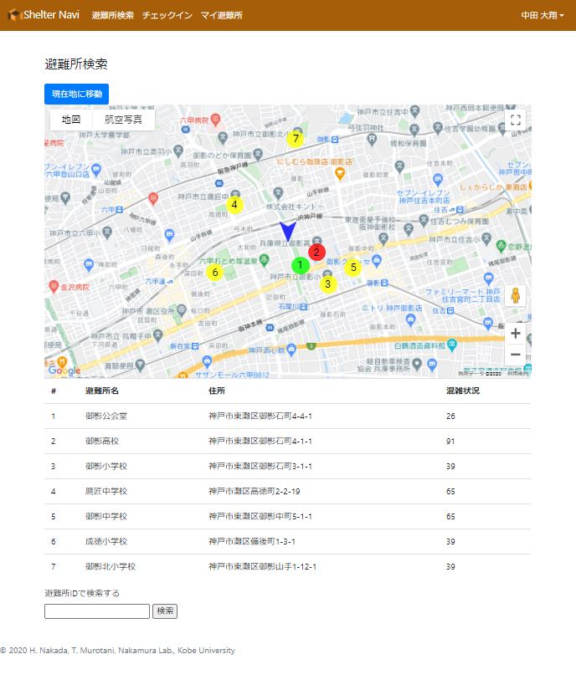
ShelterNaviプロトタイプ
ログイン画面

Slide 17
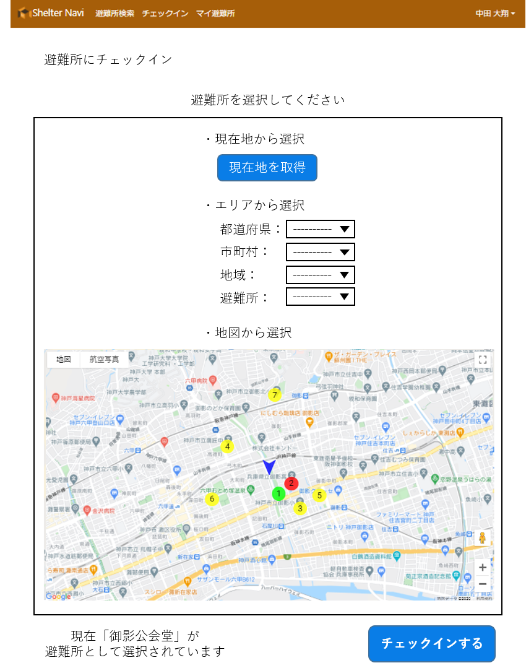
ShelterNaviプロトタイプ
ログイン画面

Slide 18
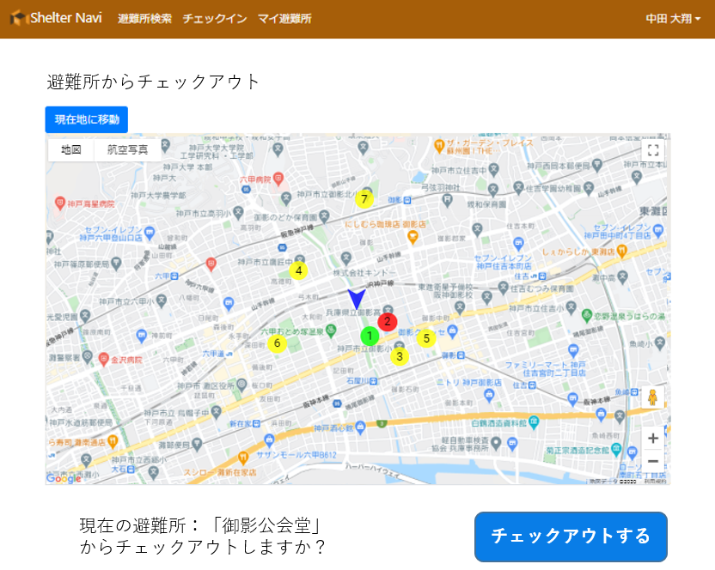
ShelterNaviプロトタイプ
ログイン画面

